Slide 1
Welcome to Back to School Night 2022-2023
Please find your child’s seat. Log in to their computer. Their username and password are provided on the red card. Please login and follow the directions on the paper provided! Please raise your hand if you need assistance.
SECOND GRADE
TRACK D
Notes:
1

Slide 2
About Me
Mrs. Atherton
Professional Experience:
Bachelor of Arts, Cal Poly Pomona
University Master of Science, California State University Fullerton
2nd Grade
4thGrade
Notes:
2

Slide 4
Homework*
District guidelines are 20-30 of focused minutes daily as well as an additional 20 minutes a day of outside reading.
Homework will be assigned Monday through Thursday.
1. Read: 20 minutes.
2. Math: Math workbook will be kept at home. Complete Flashcards 10 minutes daily.
3. Unfinished classwork.
4.Test prep when necessary.
Notes:
4

Slide 5
Friday’s math homework will be optional.

Slide 6
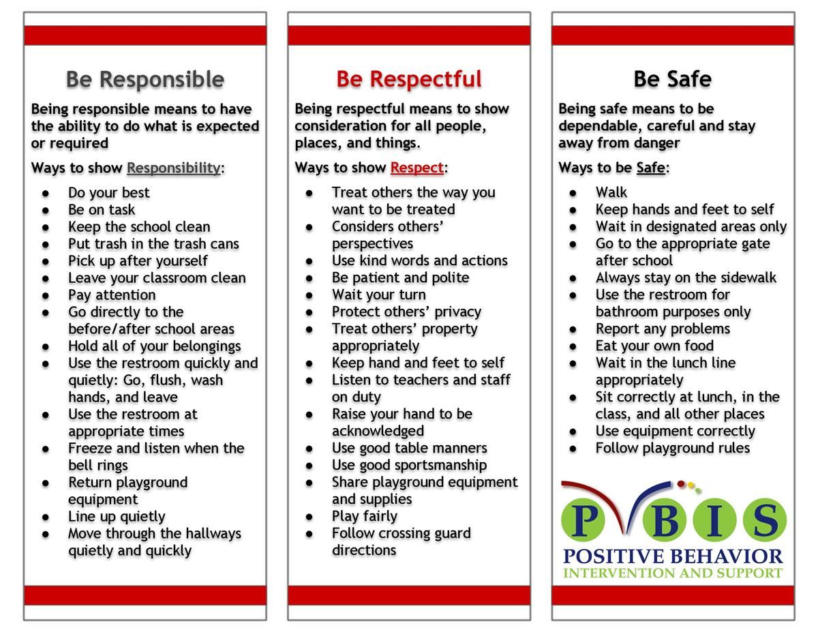
School Wide Behavior Expectations
Rick Morris Behavior Clionstrates exemplary behavior hone call home, email, or notification on daily behavior calendar.

Slide 7
Incident Logs
Incident Logs are used for OUTSIDE minor playground offenses.
Examples: running before, during, or after school, pushing, playing after bell, using bathroom after the bell …
Parent signature REQUIRED
Grades 1-6
Incident Logs will warrant the following consequences (per trimester):
1st: Warning
2nd: Loss of a recess and citizenship grade on the report card lowered one level
3rd: Office referral for 1 lunch detention
4th: Parent/Student/Teacher Conference with an Administrator

Slide 8
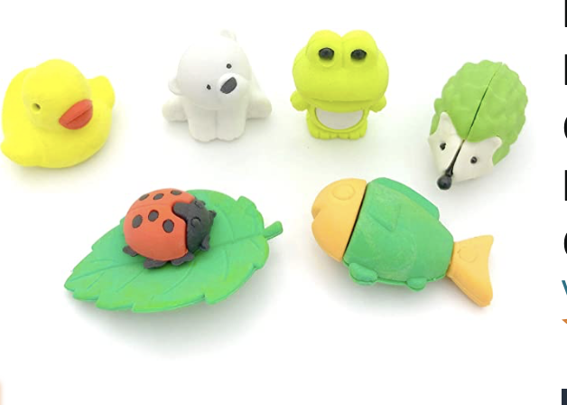
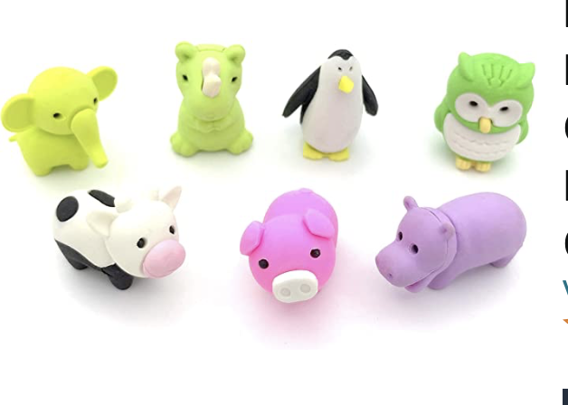
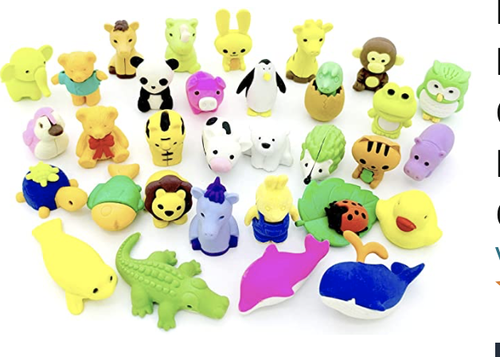
Behavior Expectation Rewards
Student’s will earn AIM High points for positive behavior both in the classroom and on the playground.
Students will be able to redeem points to purchase DESK PETS!

Slide 9
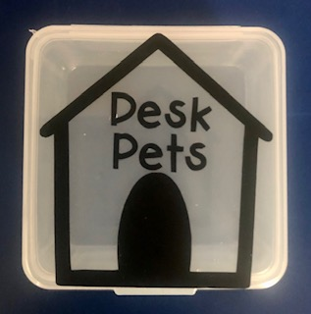
How does my student earn a Desk Pet?
Follow directions quickly.
Be kind with words and actions.
Be ready to learn and have all necessary materials.
Stay focused in line. Stay distance and walk with a purpose.
Stay on task and complete class work.
When students do these things, they can earn up to 25 points a week! “Jack’s Pet Shop”
will be open approximately every two weeks.
Students can buy; pets, accessories, food for their pets, and supplies to build their pet’s habitat.

Slide 11
Classwork
It is important that each student completes his/her classwork. If classwork is not finished in the time allotted, the student will have to complete it at during recess or at home.
Please check your child’s “ Take Home” folder daily.
Notes:
11

Slide 12
Grading Policy
All grades are a combination of class work, tests, quizzes, class participation, homework, and/or teacher observation.
Notes:
12

Slide 13
Grading Scale
Grade/Number | Meaning
4- Excelling | Student is at the Excelling level of performance. They have an in-depth understanding of grade level performance standards expected at this point in the school year.
3- Achieving | Student is at the Achieving level of performance. They are consistently meeting the grade level performance standards expected at this point in the year.
2- Progressing | Student is at the Progressing level of performance. They are partially meeting the grade level performance standards expected at this point in the year.
1- Beginning | Student is at the Beginning/Standard Not Met level and is not yet meeting grade level performance standards expected at this point in the year.
Standards Based Grading Report Card, resulting in students receiving the grades of 1, 2, 3, and 4.

Slide 14
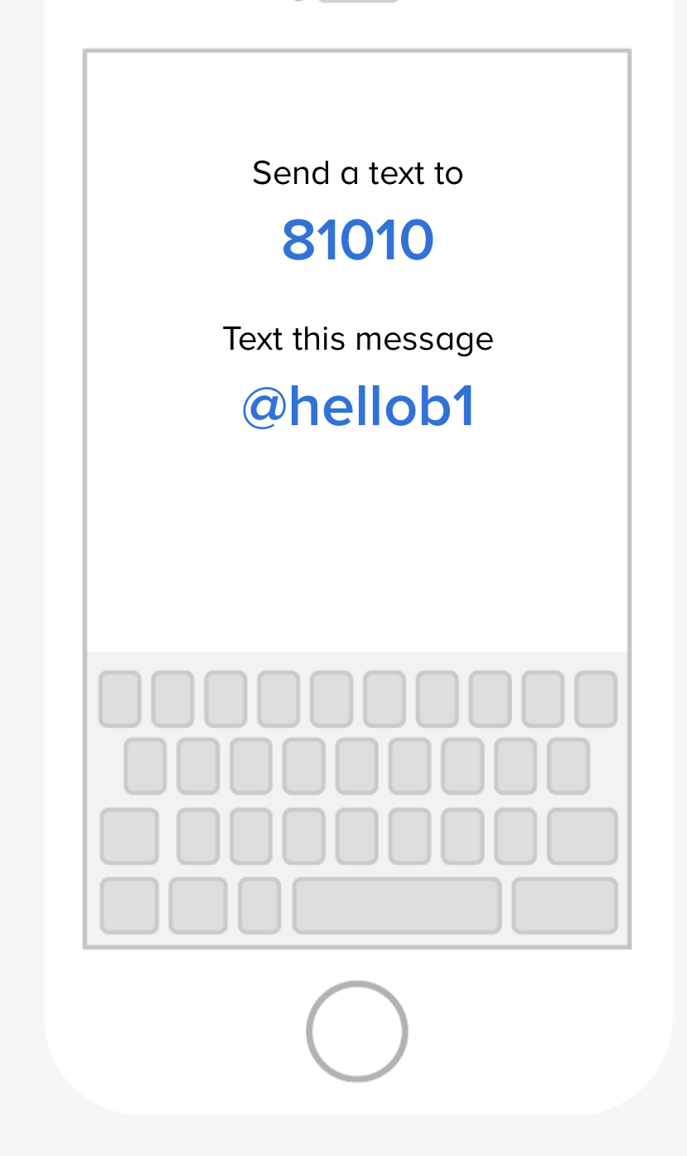
This is the best way to contact me!
This Photo by Unknown Author is licensed under CC BY-NC

Slide 15
Parent-Teacher Conferences are coming up.
9/12 - 9/14
Please sign up for a date/time on Sign-Up Genius on our classroom page when you receive the notification.
Notes:
15

Slide 16
Absences
Please make sure your child is in school unless ill.
ATTENDANCE COUNTS!
Please try to schedule appointments after school. If you are taking your child out of school, please let me know ASAP. Work missed will need to be completed.
Missed tests will be given the next day the student returns or when time permits.
TARDIES do count against perfect attendance!
Notes:
16

Slide 17
Student Recognition
There will be 3 awards assemblies this year.
Top Flight
Captain
Lieutenant
Perfect attendance
(no absences, and no more than 2 tardies or leaving school early)

Slide 18
We’re College Bound!
University of Hawaii
Wear College Bound shirt every Monday and
Aviator shirt on Fridays!
Notes:
18

Slide 21
School Supplies
Please replenish necessary school supplies throughout the year as needed.
Pencils, Paper, Crayons, Glue Sticks, etc.
Notes:
21

Slide 22
Classroom Donations
White copy paper
(8 ½ x 11)
Unscented baby wipes,
Expo Markers
Pencils
Glue sticks
Amazon Wish List
https://www.amazon.com/hz/wishlist/ls/2SQRCBYMN8HAH?ref_=wl_share

Slide 23
McGraw-Hill Reading Wonders
ELA Curriculum
Focus will be on:
Vocabulary Instruction
Reading Comprehension Skill Development
Phonics
Spelling
Grammar
Writing
Writing Domains:
Informational
Narrative
Opinion
Online Access:
Online access for students and parents can be found on your child’s ClassLink account.

Slide 24
Math Curriculum Savvas Envision Math
Focus will be on:
Operation and Algebraic Thinking
Numbers and Operations in Base Ten
Measurement and Data
Geometry
Online Access:
Online access for students and parents can be found on your child’s ClassLink account.
Supplemental programs utilized daily on Chrome books in class.
Prodigy
Extra Math

Slide 25
Other Core Subjects English Language Development (ELD)​ - Remediation, Intervention & Enrichment​ - Social Studies- Houghton Mifflin-NGSS​ - Science- NGSS​ TWIG Click 99999999 - P.E. – Appropriate shoes​ - Music- Once a week​ -Library

Slide 26
Goals for the Year
Have every student reach or exceed Common Core State and District standards.
Provide a safe, fun-filled, nurturing learning environment where children thrive.
Increase each child’s academic success in all subject areas.
Develop students’ organizational skills and sense of responsibility.

Slide 28
Classroom Wishlist
Raz-Kids
https://www.raz-kids.com
Online guided reading program with interactive ebooks, downloadable books, and reading quizzes.
Amazon Classroom Wishlist
https://www.amazon.com/hz/wishlist/ls/2SQRCBYMN8HAH?ref_=wl_share
$ 118.00 yearly.
Requesting
$ 5.00 per student
Already purchased. Requesting 5.00 per student.
@Mari-Atherton

Slide 29
Contact Information
Please feel free to send me a note or an email regarding any questions or concerns.
Cal Aero Preserve (909) 606-8531
Text Cell (562) 6953850
Mari_Atherton@chino.k12.ca.us
I’m looking forward to a terrific year!
Thank you ☺
Notes:
29

